Slide 1

REPORT

Slide 2


CONTENTS
01
02
03
04
Copy paste fonts. Choose the only option to retain text.
Copy paste fonts. Choose the only option to retain text.
Copy paste fonts. Choose the only option to retain text.
Copy paste fonts. Choose the only option to retain text.

Slide 3

01
Copy paste fonts. Choose the only option to retain text.

Slide 4


Text here
Text here
Copy paste fonts. Choose the only option to retain text.
……
Copy paste fonts. Choose the only option to retain text.
……
Text here
Text here
Copy paste fonts. Choose the only option to retain text.
……
Copy paste fonts. Choose the only option to retain text.
……

Slide 5
02
Copy paste fonts. Choose the only option to retain text.

Slide 6


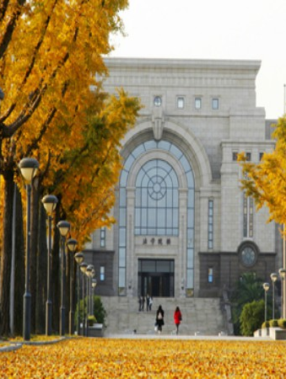

30K
50K
70K
88K
2018 Q1
2018 Q2
2018 Q3
2018 Q4
Supporting text here. When you copy & paste, choose "keep text only" option.
Supporting text here. When you copy & paste, choose "keep text only" option.
Supporting text here. When you copy & paste, choose "keep text only" option.
Supporting text here. When you copy & paste, choose "keep text only" option.

Slide 7
03
Copy paste fonts. Choose the only option to retain text.

Slide 8

Text here
Text here
Copy paste fonts. Choose the only option to retain text.
Copy paste fonts. Choose the only option to retain text.
Text here
Text here
Copy paste fonts. Choose the only option to retain text.
Copy paste fonts. Choose the only option to retain text.
Text here
Text here
Copy paste fonts. Choose the only option to retain text.
Copy paste fonts. Choose the only option to retain text.

Slide 9
04
Copy paste fonts. Choose the only option to retain text.

Slide 10
XXXXXXXXXX
Jan
Feb
Mar
Apr
May
June
July
Aug
Sep
Oct
Nov
Dec
XXXXXX
XXXXX
XXXXXX
XXXXXXXX
XXXX
XXXXX
XXXXXX
XXXXXXX
XXX

Slide 11
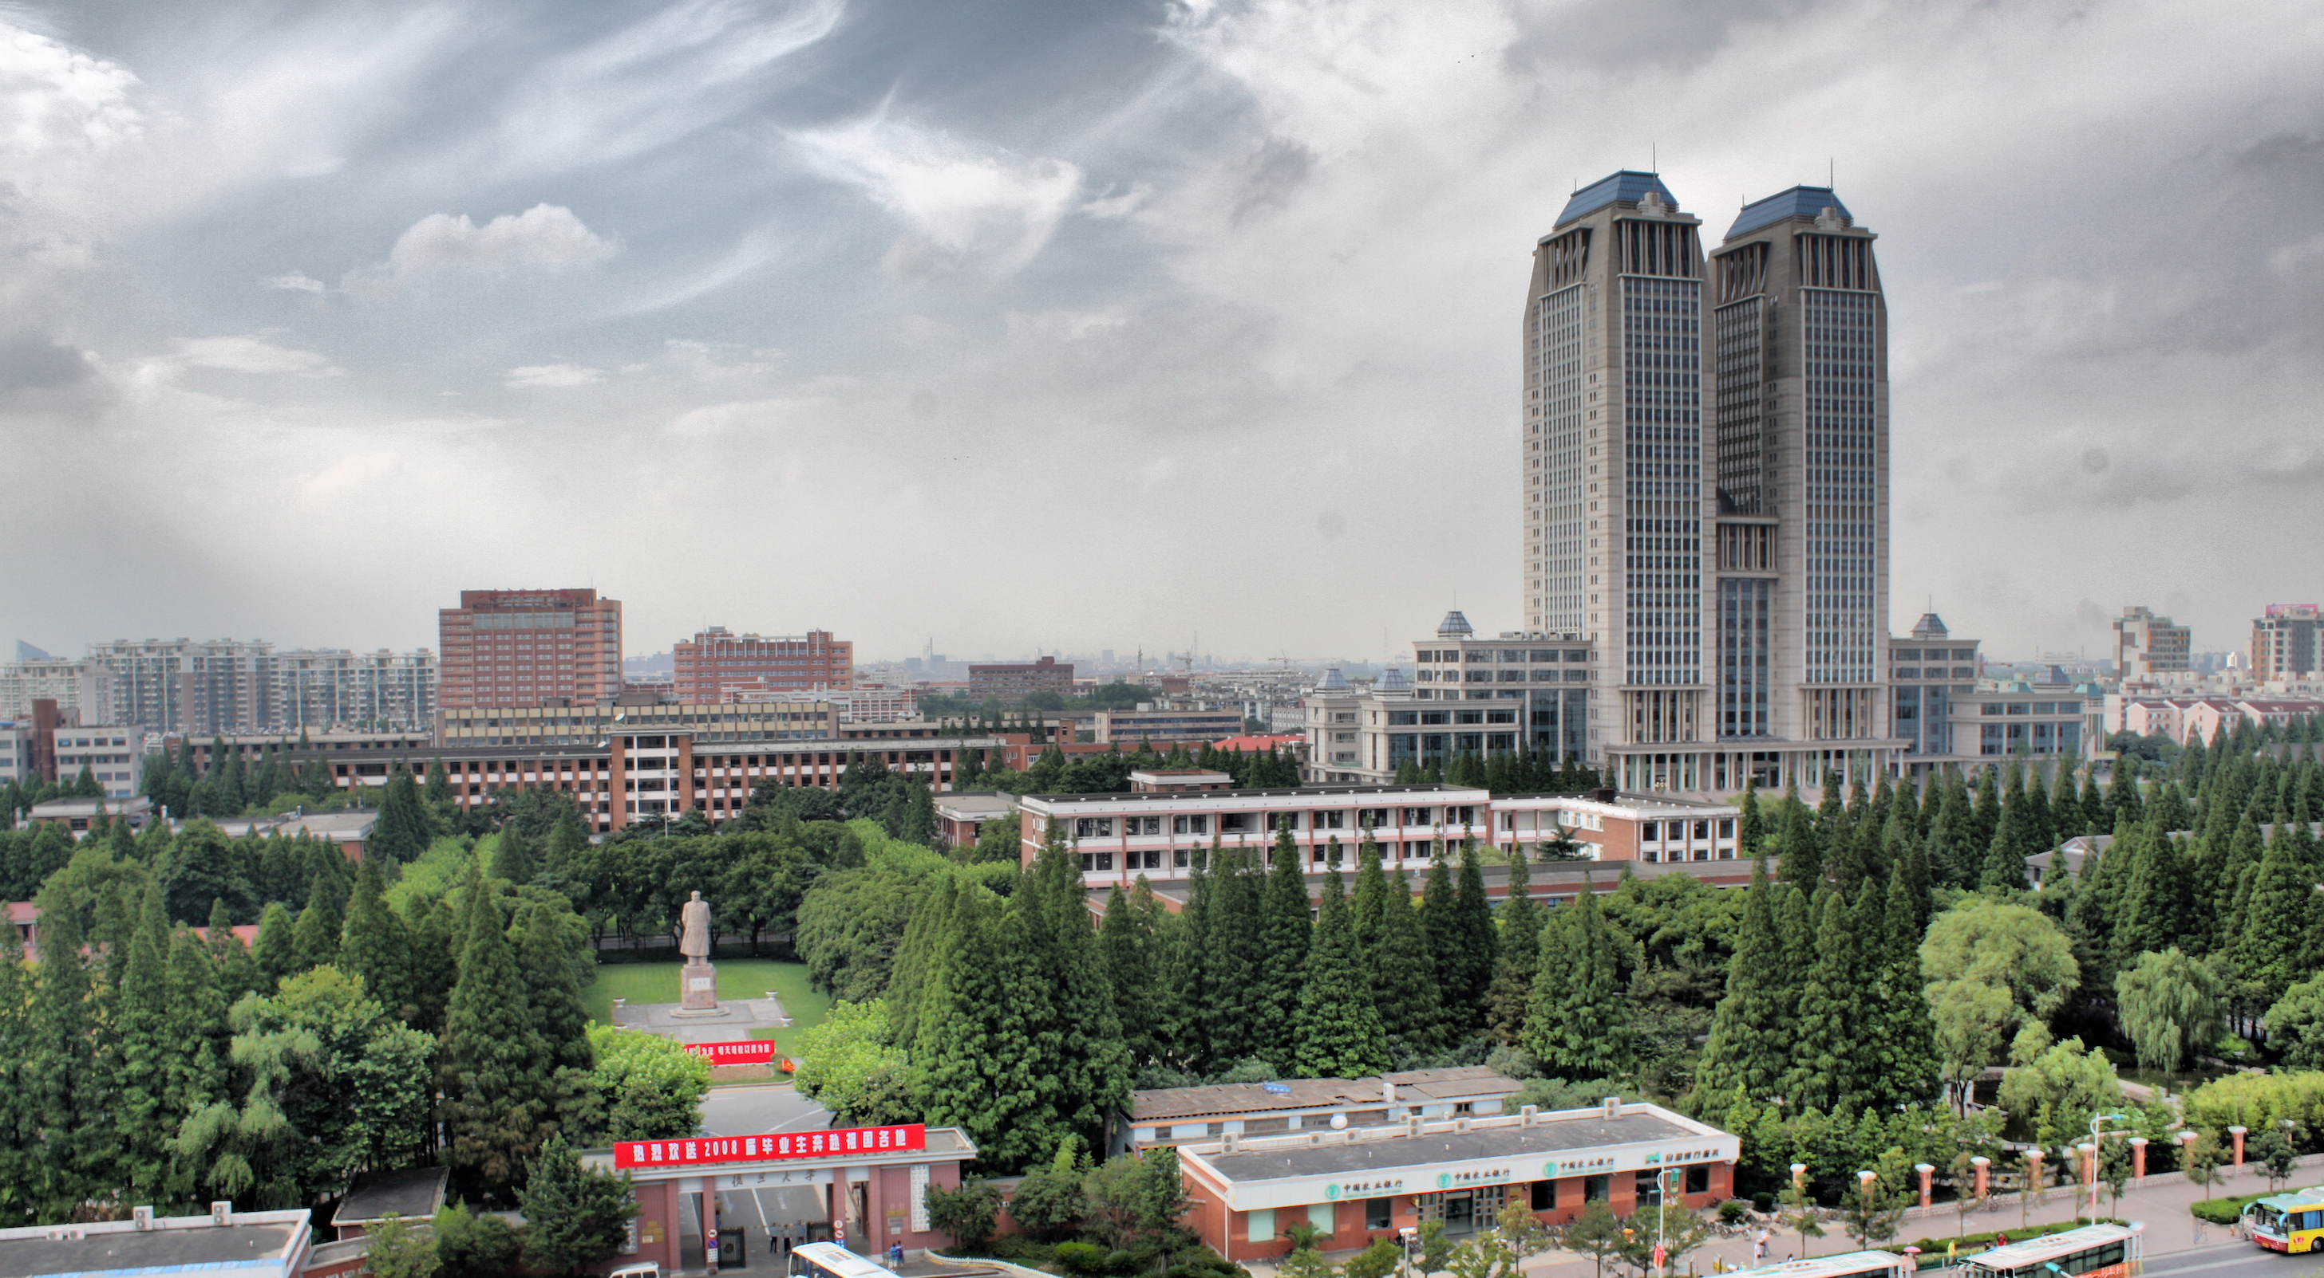
THANKS

